Slide 1
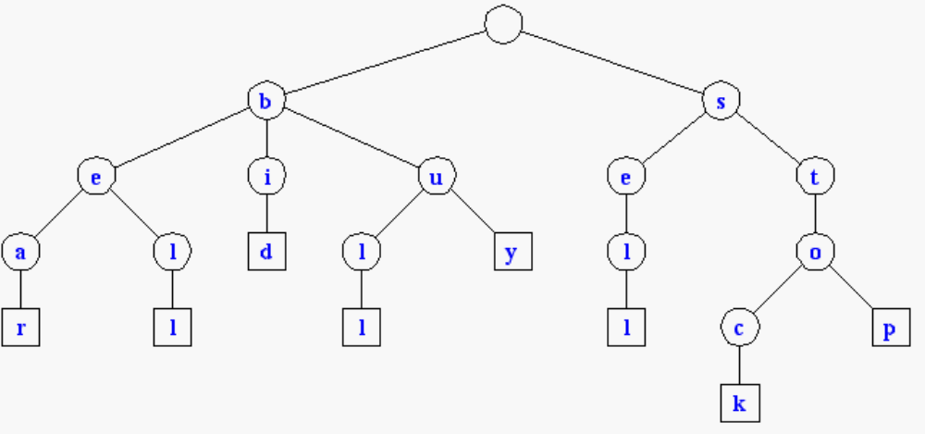
Tries
Standard Tries
Compressed Tries
Suffix Tries

Slide 2
Tires
Strings can essentially be viewed as the most important and common topics for a variety of programming problems. String processing has a variety of real world applications too, such as:
  Search Engines
  Genome Analysis
  Data Analytics
All the content presented to us in textual form can be visualized as nothing but just strings.

Slide 3
Tries are an extremely special and useful data-structure that are based on the prefix of a string. They are used to represent the “Retrieval” of data and thus the name Trie.
Prefix : What is prefix:
The prefix of a string is nothing but any n letters n≤|S| that can be considered beginning strictly from the starting of a string.
For example , the word “abacaba” has the following prefixes:
a
ab
aba
abac
abaca
abacab

Slide 4
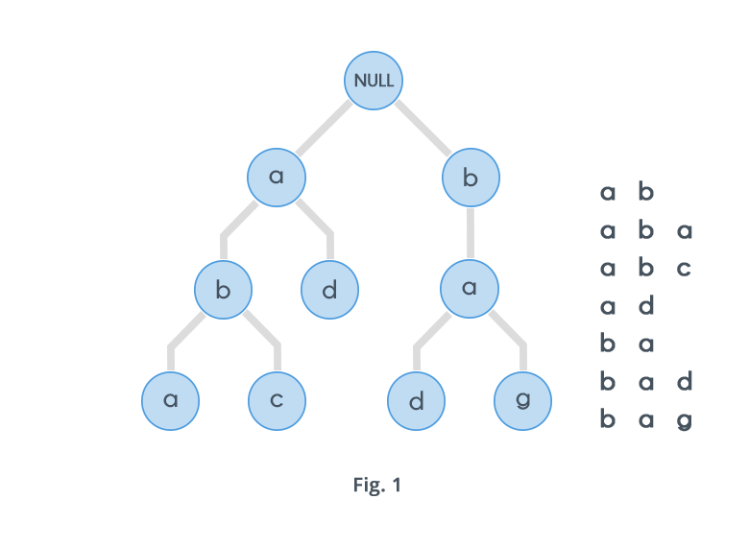
A Trie is a special data structure used to store strings that can be visualized like a graph.
It consists of nodes and edges.
Each node consists of at max 26 children and edges connect each parent node to its children.
These 26 pointers are nothing but pointers for each of the 26 letters of the English alphabet A separate edge is maintained for every edge.
Strings are stored in a top to bottom manner on the basis of their prefix in a trie.
All prefixes of length 1 are stored at until level 1, all prefixes of length 2 are sorted at until level 2 and so on.
Ex: English Dictionary

Slide 5
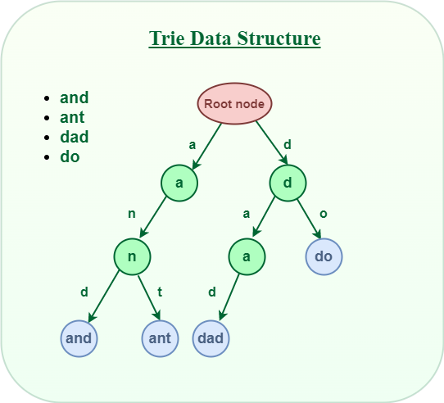
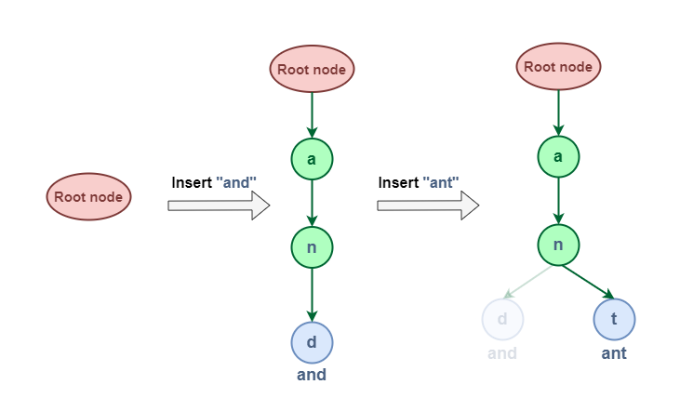
Trie is a type of k-ary search tree used for storing and searching a specific key from a set. Using Trie, search complexities can be brought to optimal limit (key length).
Insert Operation

Slide 6
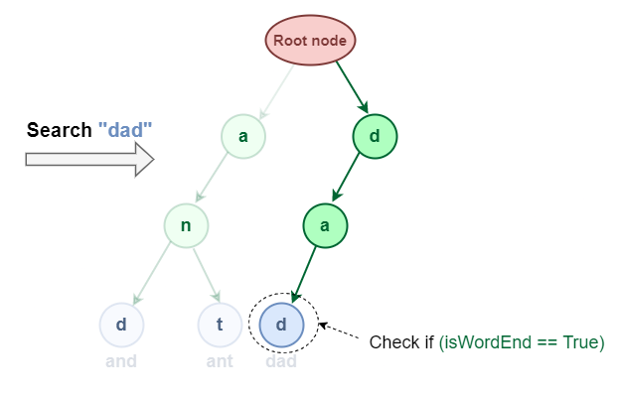
Search operation

Slide 7
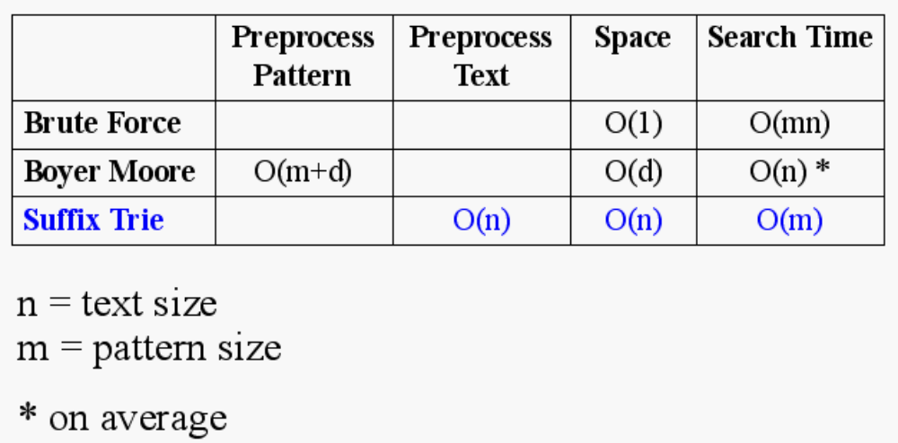
Text Processing
We have seen that preprocessing the pattern speeds up pattern matching queries
After preprocessing the pattern in time proportional to the pattern length, the Boyer-Moore algorithm searches an arbitrary English text in (average) time proportional to the text length
If the text is large, immutable and searched for often (e.g., works by Shakespeare), we may want to preprocess the text instead of the pattern in order to perform pattern matching queries in time proportional to the pattern length.
Tradeoffs in text searching

Slide 8
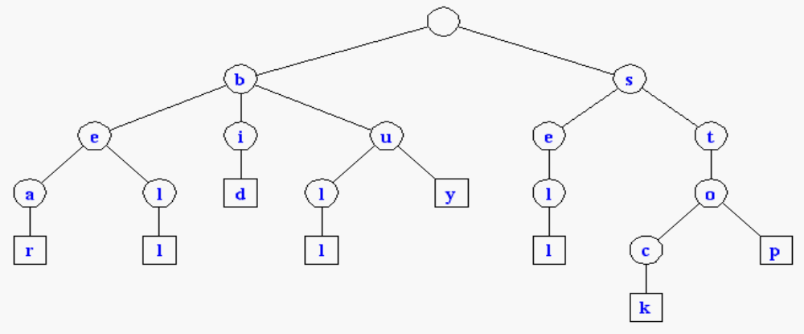
Standard Tries
The standard trie for a set of strings S is an ordered tree such that:
  each node but the root is labeled with a character
  the children of a node are alphabetically ordered
  the paths from the external nodes to the root yield the strings of S
Example: standard trie for
the set of strings
S = { bear, bell, bid, bull,
buy, sell, stock, stop }
A standard trie uses O(n) space. Operations (find, insert, remove) take time O(dm) each, where:
-n = total size of the strings in S,
-m =size of the string parameter of the operation
-d =alphabet size,

Slide 9
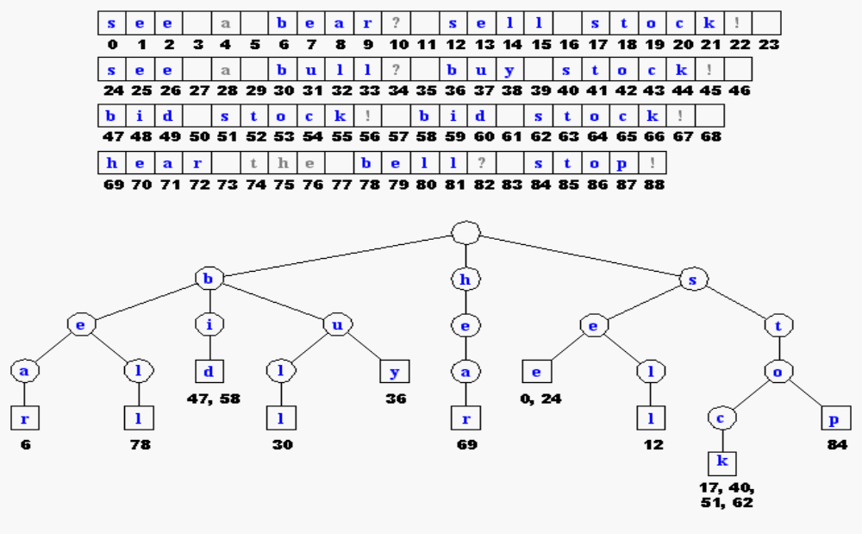
Applications of Tries
A standard trie supports the following operations on a preprocessed text in time O(m), where m = |X|
-word matching: find the first occurence of word X in the text
-prefix matching: find the first occurrence of the longest prefix of word X in the text
Each operation is performed by tracing a path in the trie starting at the root

Slide 10
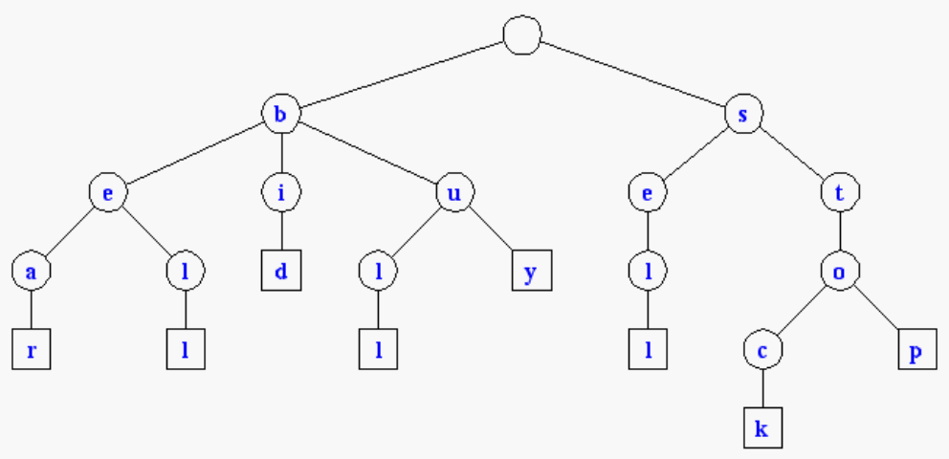
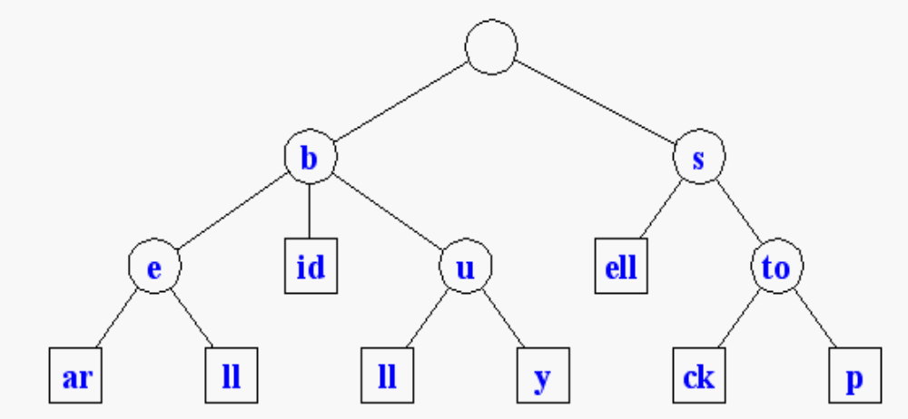
Compressed Tries
Trie with nodes of degree at least 2
Obtained from standard trie by compressing chains of redundant nodes
Standard Trie:
Compressed Trie:

Slide 11
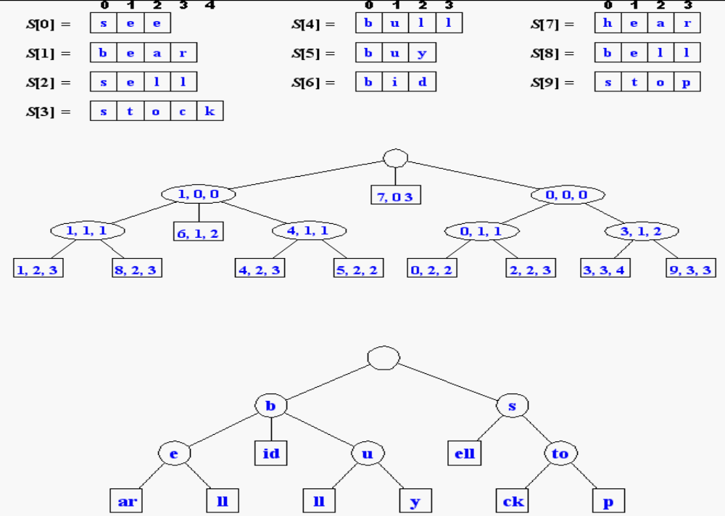
Compact Storage of Compressed Tries
A compressed trie can be stored in space O(s), where s = |S|, by using O(1) space index ranges at the nodes

Slide 12
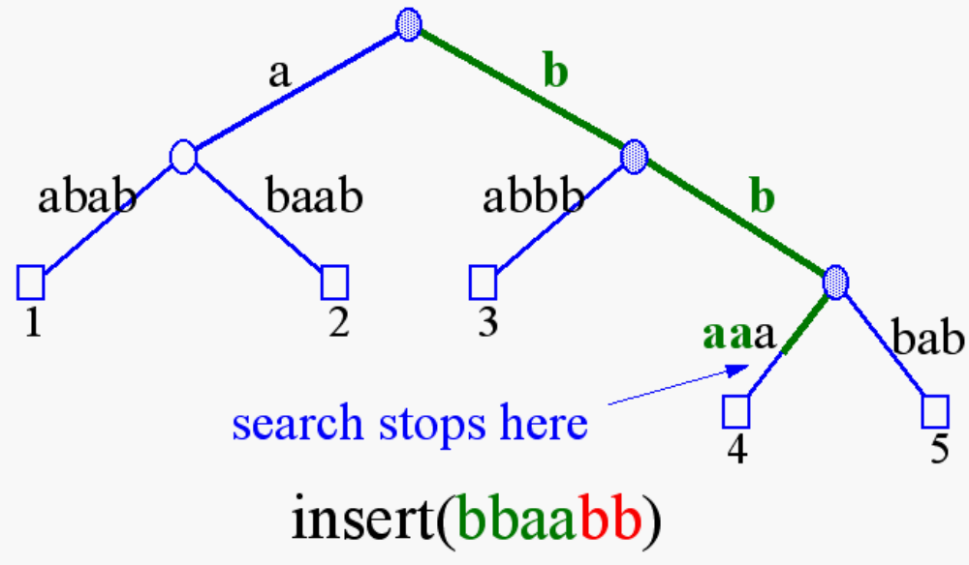
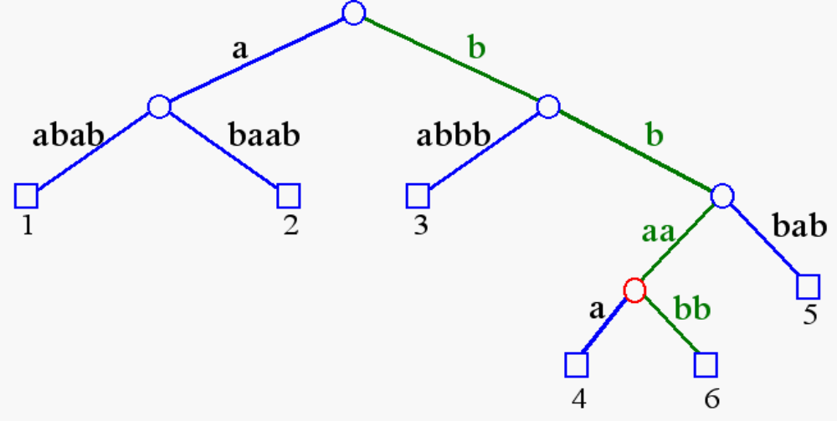
Insertion and Deletion into/from a Compressed Trie

Slide 13
Tries and Web Search Engines
The index of a search engine (collection of all searchable words) is stored into a compressed trie
Each leaf of the trie is associated with a word and has a list of pages (URLs) containing that word, called occurrence list
The trie is kept in internal memory
The occurrence lists are kept in external memory and are ranked by relevance
Boolean queries for sets of words (e.g., Java and coffee) correspond to set operations (e.g., intersection) on the occurrence lists
Additional information retrieval techniques are used, such as
  stopword elimination (e.g., ignore “the” “a” “is”)
  stemming (e.g., identify “add” “adding” “added”)
  link analysis (recognize authoritative pages)

Slide 14
Tries and Internet Routers
Computers on the internet (hosts) are identified by a unique 32-bit IP (internet protocol) addres, usually written in “dotted-quad-decimal” notation
E.g., www.cs.brown.edu is 128.148.32.110
Use nslookup on Unix to find out IP addresses
An organization uses a subset of IP addresses with the same prefix, e.g., Brown uses 128.148.*.*, Yale uses 130.132.*.*
Data is sent to a host by fragmenting it into packets. Each packet carries the IP address of its destination.
The internet whose nodes are routers, and whose edges are communication links.
A router forwards packets to its neighbors using IP prefix matching rules. E.g., a packet with IP prefix 128.148. should be forwarded to the Brown gateway router.
Routers use tries on the alphabet 0,1 to do prefix matching.

